Slide 1

A CASE STUDY OF CAR PARKING EFFICIENCY USING LICENSE PLATE METHOD NEAR ESTATE BUILDING AT IIT GUWAHATI
Geometric Design of Transportation Facilities(CE 622)
Represented by
HIMANSHU NIRWAN (234104505)
MAYANK SEMWAL (234104506)
POTNURU KARUN (234104508)
RAHUL KUMAR (234104510)
SAGNIK PAUL (234104512)
VINEET KASHYAP (234104519)

Slide 2
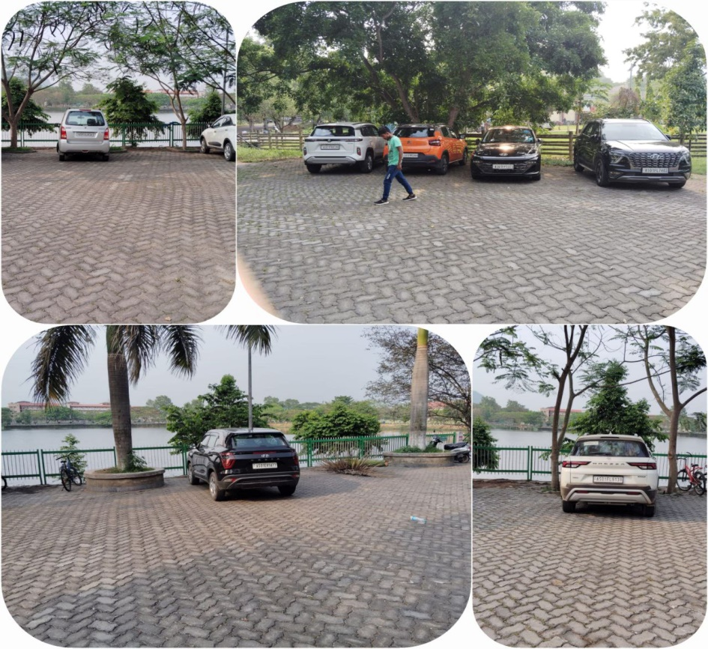
Content
Introduction
Data Collection Site
Data Collection Methodology
Analysis of Data
Result and Discussion

Slide 3
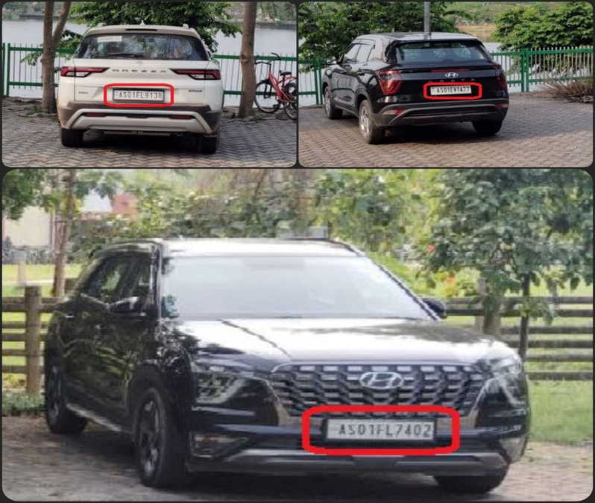
Introduction
The license plate method for the Parking Surveys is commonly used to obtain estimates on average parking duration, turnover, and accumulation.
As per IRC SP 12 (2015), parking space requirement for car parking is 20-36 sq m.
License plate method is the most accurate method and it gives the most realistic data.

Slide 4
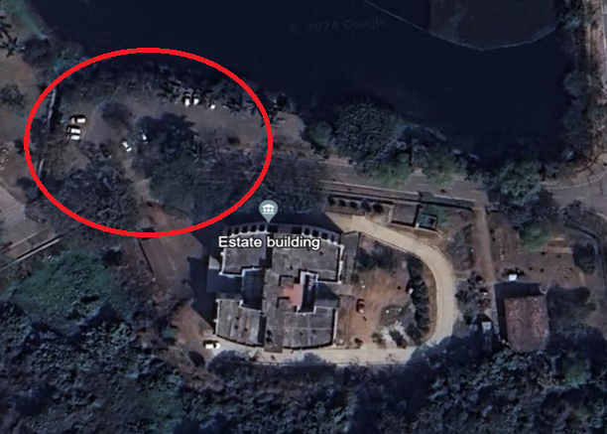
Data Collection Site
Location – In front of Estate Building (near Lakeside Tea Stall)
Date - 16.04.2024 (Tuesday)
Time – 3.00 pm – 4.00 pm

Slide 5
Data Collection Methodology
Table 1. Data entries for each bay for one hour
Bay | Time (min)
 | 0-15 | 15-30 | 30-45 | 45-60
1 | - | - | - | -
2 | 9008 | 9008 | 9008 | 9008
3 | 7829 | 7829 | - | 3542
4 | - | - | - | -
5 | 4964 | - | - | -
6 | 0396 | 0396 | 0396 | 0396
7 | 5988 | 5988 | 9520 | 9520
8 | 1373 | 1373 | 1373 | 1373
9 | 7402 | 7402 | 7402 | 7402
10 | - | - | 1032 | 1032
11 | 7525 | 7525 | 7525 | 7525
12 | 7083 | 4341 | 4341 | 4341
13 | - | - | - | -
14 | 9477 | 9477 | 9477 | 9477
15 | - | - | - | 5633
16 | 9138 | 9138 | 9138 | 9138
17 | - | - | - | -
18 | 1477 | 1477 | 1477 | 1477
19 | 5185 | 5185 | - | -
20 | - | - | 0577 | 0577
21 | 7606 | 7606 | 7606 | 7606
22 | 5123 | 5123 | 5123 | -
After selection of Parking site, divide the area into 22 number of Parking bays.
Divide 1 hour time duration into 4 sub-division, each of 15 min.
Note down the License plate number of the car parked at different Bays, for each 15 minutes.

Slide 6
Analysis of Data
Bay | Time (min) |  |  |  | Time (min) |  |  |  | Turnover
 | 0-15 | 15-30 | 30-45 | 45-60 | 15 | 30 | 45 | 60
1 | - | - | - | - | 0 | 0 | 0 | 0 | 0
2 | 9008 | 9008 | 9008 | 9008 | 1 | 1 | 1 | 1 | 1
3 | 7829 | 7829 | - | 3542 | 1 | 1 | 0 | 1 | 2
4 | - | - | - | - | 0 | 0 | 0 | 0 | 0
5 | 4964 | - | - | - | 1 | 0 | 0 | 0 | 1
6 | 0396 | 0396 | 0396 | 0396 | 1 | 1 | 1 | 1 | 1
7 | 5988 | 5988 | 9520 | 9520 | 1 | 1 | 1 | 1 | 2
8 | 1373 | 1373 | 1373 | 1373 | 1 | 1 | 1 | 1 | 1
9 | 7402 | 7402 | 7402 | 7402 | 1 | 1 | 1 | 1 | 1
10 | - | - | 1032 | 1032 | 0 | 0 | 1 | 1 | 1
11 | 7525 | 7525 | 7525 | 7525 | 1 | 1 | 1 | 1 | 1
12 | 7083 | 4341 | 4341 | 4341 | 1 | 1 | 1 | 1 | 2
13 | - | - | - | - | 0 | 0 | 0 | 0 | 0
14 | 9477 | 9477 | 9477 | 9477 | 1 | 1 | 1 | 1 | 1
15 | - | - | - | 5633 | 0 | 0 | 0 | 1 | 1
16 | 9138 | 9138 | 9138 | 9138 | 1 | 1 | 1 | 1 | 1
17 | - | - | - | - | 0 | 0 | 0 | 0 | 0
18 | 1477 | 1477 | 1477 | 1477 | 1 | 1 | 1 | 1 | 1
19 | 5185 | 5185 | - | - | 1 | 1 | 0 | 0 | 1
20 | - | - | 0577 | 0577 | 0 | 0 | 1 | 1 | 1
21 | 7606 | 7606 | 7606 | 7606 | 1 | 1 | 1 | 1 | 1
22 | 5123 | 5123 | 5123 | - | 1 | 1 | 1 | 0 | 1
Accumulation |  |  |  |  | 15 | 14 | 14 | 15 | 21
Occupancy |  |  |  |  | 0.682 | 0.636 | 0.636 | 0.682
Average Turnover |  |  |  |  |  |  |  |  | 0.955

Slide 7
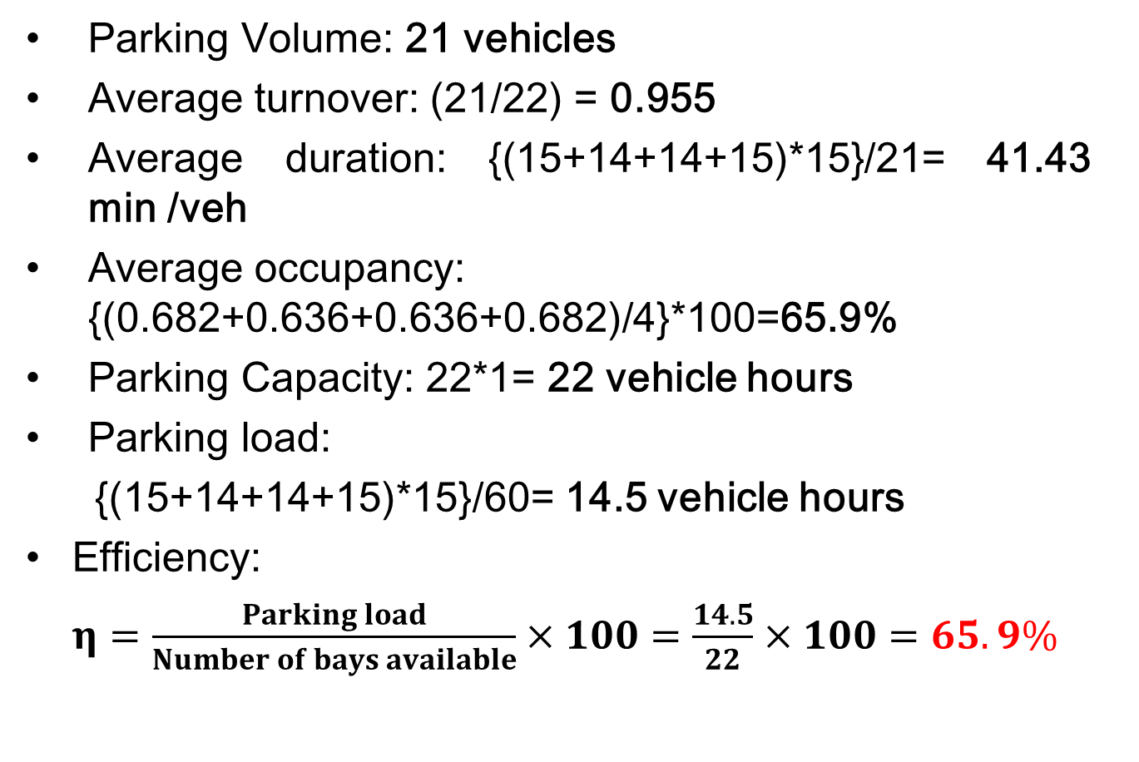
Result
Parking Volume: 21 vehicles
Average turnover: (21/22) = 0.955
Average duration: {(15+14+14+15)*15}/21= 41.43 min /veh
Average occupancy: {(0.682+0.636+0.636+0.682)/4}*100=65.9%
Parking Capacity: 22*1= 22 vehicle hours
Parking load:
{(15+14+14+15)*15}/60= 14.5 vehicle hours
Efficiency:
$η=\frac{Parking load}{Number of bays available}×100=\frac{14.5}{22}×100=65.9\%$

Slide 8
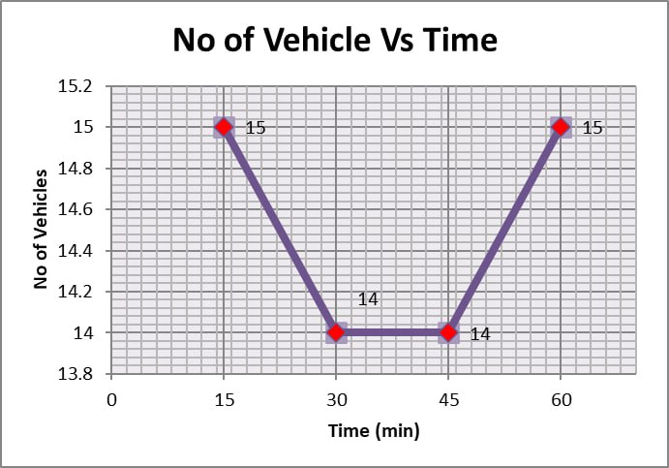
Discussion
Turnover is less than 1, it indicates that the number of vehicle parked in the given duration is less than the number of bays available.
Increasing parking turnover(more than 1) can improve the better use of parking spaces.

Slide 9
THANK YOU

